Slide 1

Strategic and tactical decisions for positive engagement during challenging times
Jessamyn West
kimball public library - flickr foundation - Vermont mutual aid society
Notes:
Strategic and tactical decisions for positive engagement during challenging times
(Hello, thank you for having me. I've been told the whiteboard is open so that you can interact anonymously during this talk - I'll keep half an eye on that and the chat, feel free to introduce yourself, and we will have time for questions/discussion at the end)

Slide 2
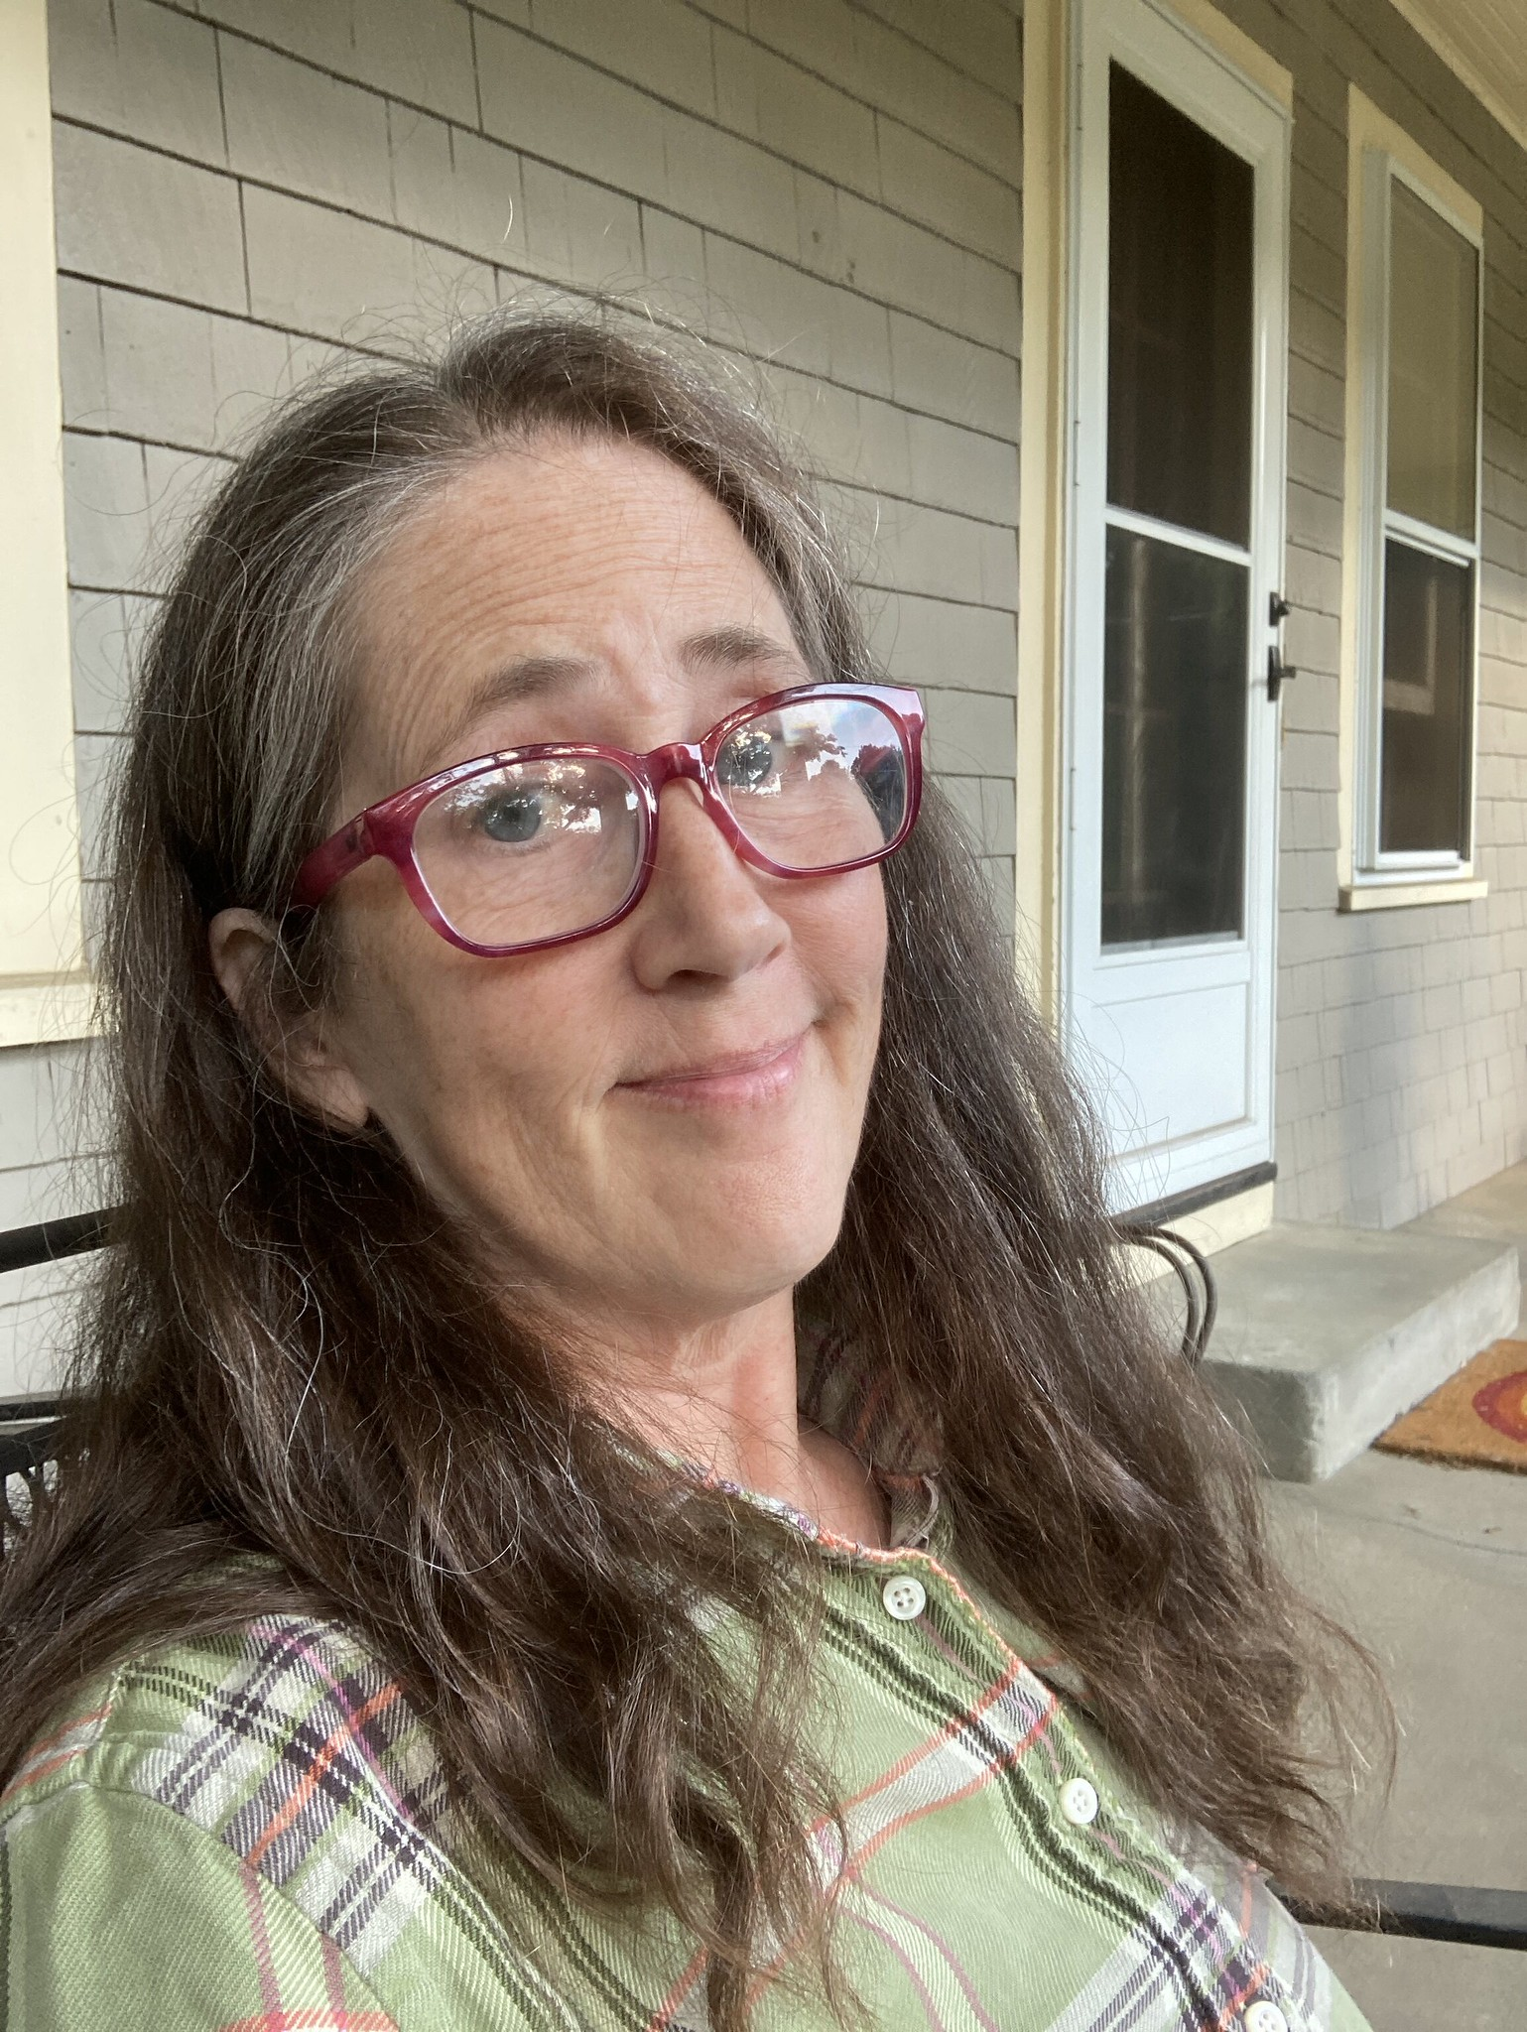
Hello.
I'm Jessamyn.
- Librarian
- Community engagement specialist
- Technology enthusiast
- Elected official
- Middle-aged cishet white lady
- Jewish
- Antifa
Notes:
Hi, I'm Jessamyn. I'm a rural librarian and library technologist living in Vermont. I've been helping people use software since there's been software. I am not, however, a media librarian and I will say that I can only imagine the sea change which has happened in that profession as the progression to streaming services and LIBRARY streaming services has matured over the past decade or two. Even during less tough times, that's a complex job and probably not for the faint of heart. This slide has a capsule description of me including work stuff and non-work stuff. I mention this because...

Slide 3
"The personal is political and the professional is personal"
I don't love this either but here we are.
Notes:
...one of the hallmarks of These Stupid Times... as our country is undergoing a brutal dismantling of many pieces of the social safety net AND apparently the human decency requirement for living in society... one of those hallmarks is that it's become more difficult than usual to not have your identity (for lack of a better word - racial, religion, gender, country-of-origin, sexual preference) become part of the discussion in and around your workplace. We've been seeing people assaulted by government goons at work and we've seen people lose their jobs because of personal beliefs (which they often didn't even bring to work) and people singled out because of identity factors which have nothing whatsoever to do with their jobs.
It was feminist Carol Hanisch who popularized the phrase "the personal is political" in 1969 talking about how topics that had maybe previously been thought of as "private" matters or existing in the private sphere (housework, abortion, structures of oppression) were not, in fact, private matters but issues that were institutionalized, built into the political structure, and would need political (among other) solutions.
Which is to say we do have, right now, an egregious intrusion of politics into our home lives and work lives. Some people much more than others. But in some ways, we always have.

Slide 4

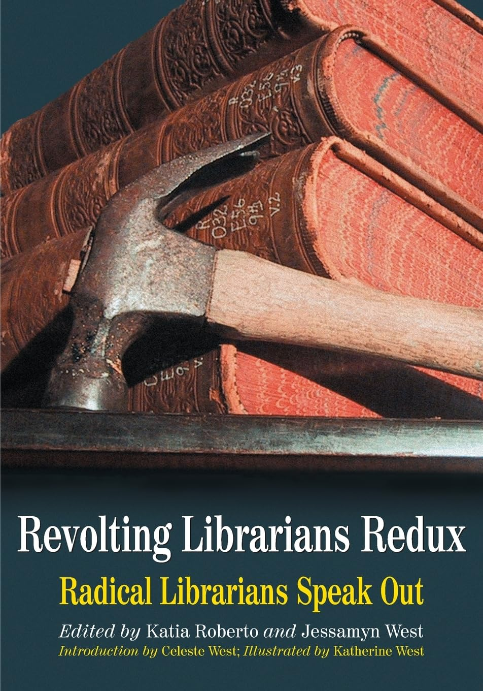
Revolting
Librarians 1 & 2
Notes:
This is especially true of librarians who have often been at the forefront of political change, advocating for more social justice and equity. When I was in library school I read this book, Revolting Librarians, which had essays from many librarians working for social change at a time before women could own credit cards in the US, when abortion was illegal, and interracial marriage had only been legal nationwide for about five years thanks to Loving v. Virginia. That book inspired me to get politically engaged, not just at home but also at work. I've been fortunate enough to mostly be in workplaces where this is a possibility, I'm aware we're not all as fortunate. [book covers from 2003 & 1973] This is not a discussion of librarian values, mostly.

Slide 5

this was going to be a very different talk before
last tuesday
(even a little different since Sunday night)
Notes:
This was going to be a very different talk before November 4th, and it's a slightly different talk than the one I was done with on November 9th. The suggestions I'll be making won't be that different, but the context will be. Speaking of Virginia, they elected Abigail Spanberger, a Democrat who ran on an anti-DOGE platform and openly opposed her opponent's transphobia. In fact, most of the transphobes in major elections--people who spent a lot of their party's or their PACs money thinking transphobia was a wedge issue they could use to court conservative voters--lost. This is not to say that we're not still, currently, living under a kleptocracy which resembles fascism in many current ways, just that we're getting a strong vibe that maybe there are a lot of people who don't LIKE that.

Slide 6
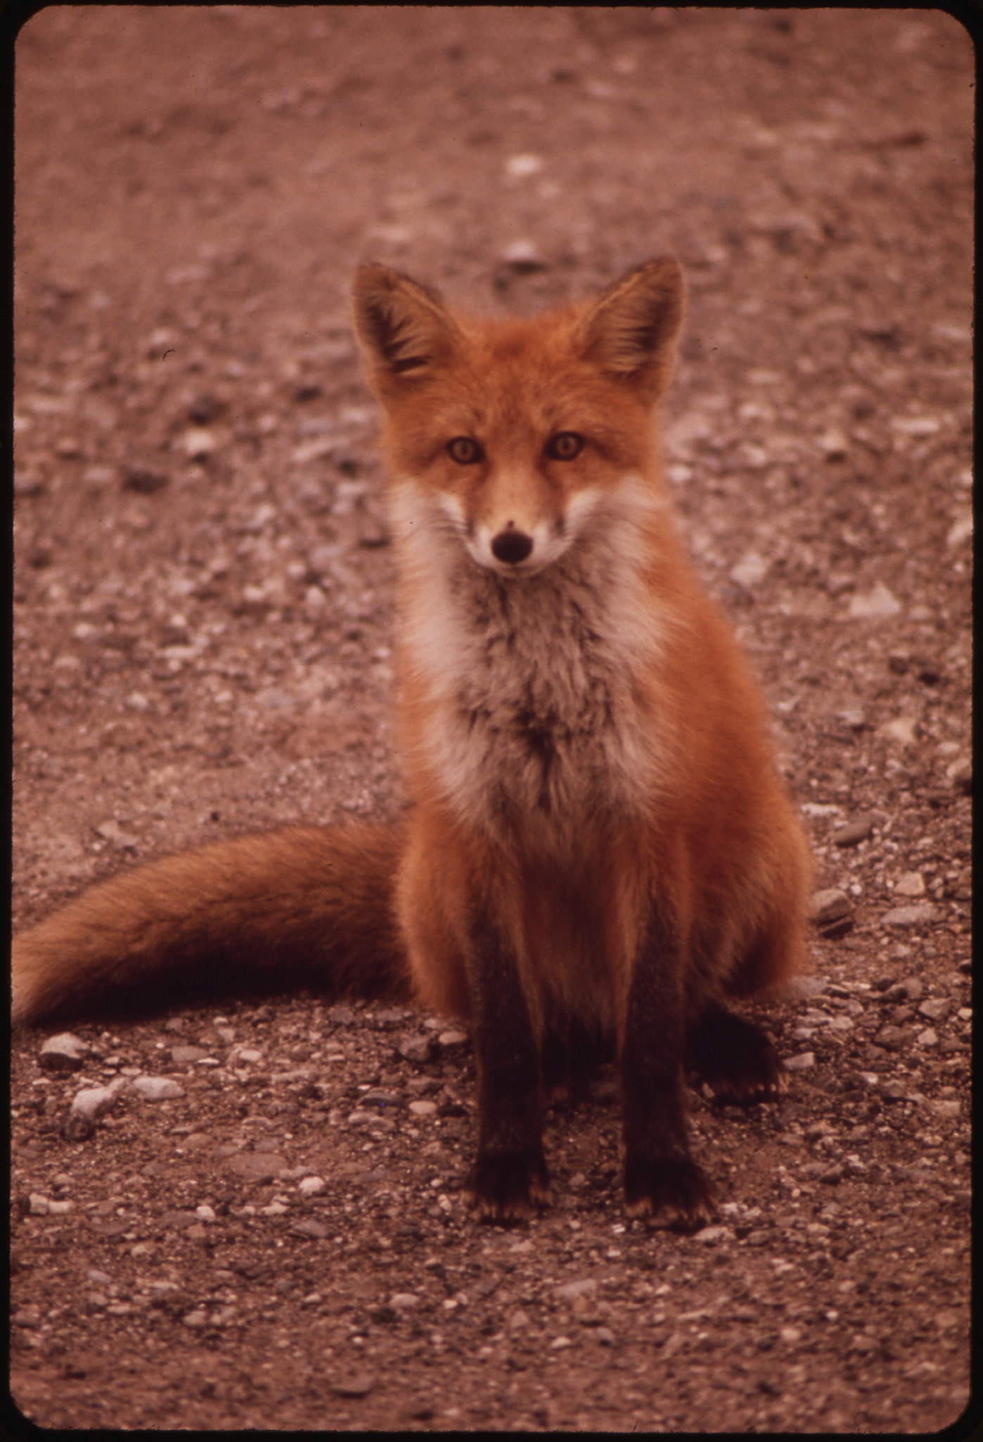
Go with your love to the fields.
Lie down in the shade. Rest your head
in her lap. Swear allegiance
to what is nighest your thoughts.
As soon as the generals and the politicos
can predict the motions of your mind,
lose it. Leave it as a sign
to mark the false trail, the way
you didn’t go. Be like the fox
who makes more tracks than necessary,
some in the wrong direction.
Practice resurrection.
- Wendell Berry
Notes:
This was last week's framing. Like many library people, I find utility in the words of others and especially, lately, in poetry. This is part of a poem about marriage and farming (and religion a little) but honestly to me it's about rising to the current moment. I'll explain.
We have always had a professional culture built on openness and sharing and it's not the easiest thing to move forward operating as if sharing might not be optimal, as if openness could be a liability. I know that people have a lot of advice right now. One of the things that people CAN do when they feel that they can't do much, is advise. It's a caring action but one which can sometimes not work in individual contexts (I think of protest advice to not bring your kids, leave your cell phone at home etc. not everyone has the same threat model or is going to the same protests).
I have been asked to give some advice but to also be brief. Please use the white board or chat to make other suggestions. We are all in this together.

Slide 7
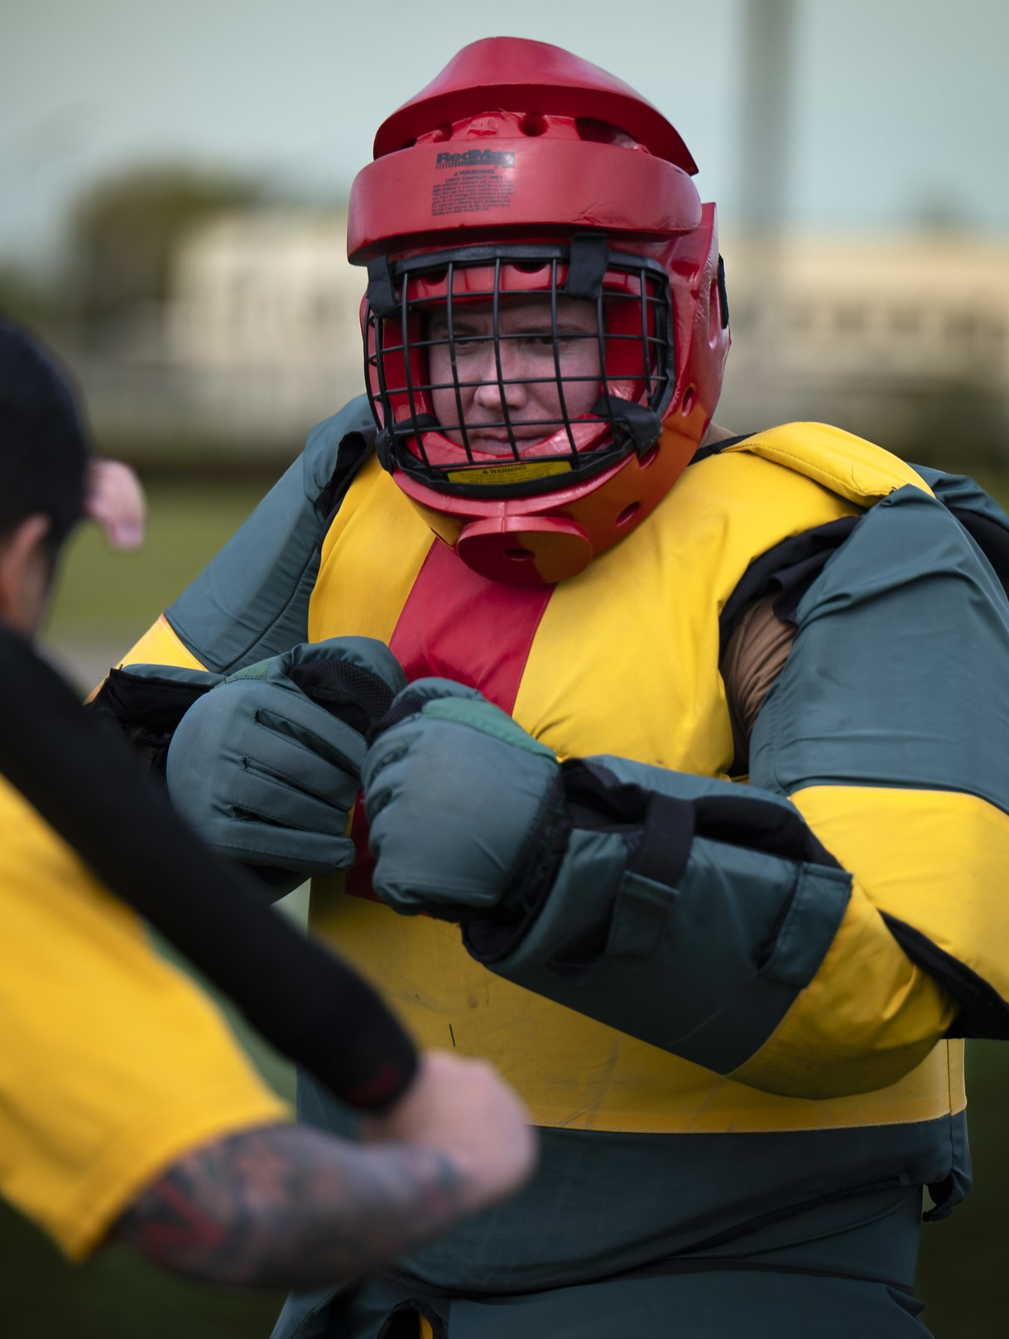
Specifically?
protect yourself
Be aware of what you look like online. Speak and act publicly with intent.
Assess your own level of risk
Make tactical determinations whether your workplace has your back or not and act accordingly. If they don't, find colleagues who do.
Consider passive sabotage.
Notes:
To speak to openness at a personal level. We are all people first and employees second. If you are in a situation where you do not feel safe from the government (or co-workers) it's okay to be more circumspect or use fewer of your personal details online. I think of this both for "non-supportive human eyeballs may be seeing this" but also "AI bots could be ingesting this" It's the difference between posting to your work blog from a personal account vs. a "library staff" account.
For some of us, the community of the workplace may have changed and may need reevaluating. In the same way you should be suspicious about any boss who wants to tell you that your work colleagues are "like a family" (they may be, but that's for you to determine) you may have to look for community in a different subset of your co-workers, or the larger network of people in similar circumstances. If you're in a negative space or confronted with unworkable work situations, passive sabotage is its own entire topic but there's a link at the end for a field manual and ways to not comply in advance. This doesn't have to be super complicated or require any real spy skills or even bravery just things like "Play dumb when DOGE wants to come into your office" or "make people explain the new dumb anti-DEI rule a few more times before you take any action" sorts of things.

Slide 8


Notes:
Maybe you have to remove materials from your collection. Maybe there is another place people could access those materials?

Slide 9

Notes:
Maybe you're not really comfortable or confident in using tools which enhance privacy at work? There are friendly people who can teach you. For free.

Slide 10
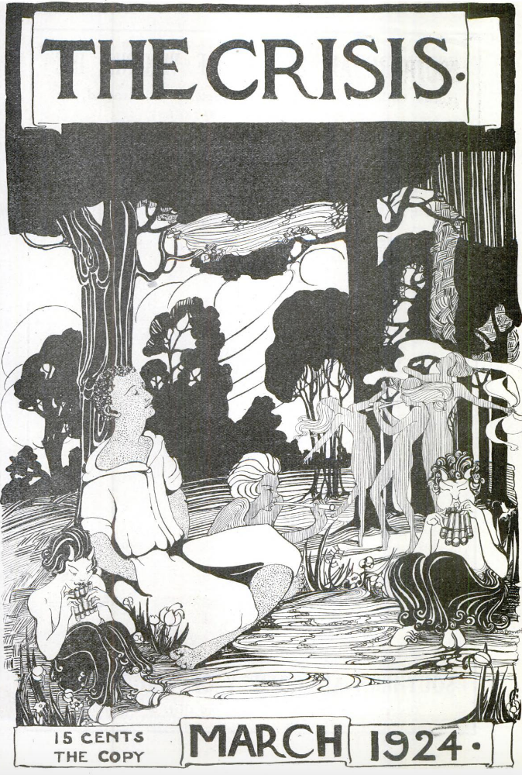
Specifically?
get the word out, use your existing skills
Familiarize yourself with samizdat (ICE awareness zines, little free libraries of resistance)
Ally with similar organizations (maybe you can talk when they can't and vice versa)
Storytell about where you are. Use your storytelling skills to highlight the stories which should be told. Encourage people to dig deeper to find out what is really going on.
Notes:
Along those same lines, library workers especially, but anyone, can make it clear that they are in that group which Mister Rogers called "the helpers." Sometimes this can just be as little as saying "We see what's happening. We see you."
Similarly, using your space to build community, all sorts of community, any kind of community, is essential. One of my little acts of resistance has been to go to interstate highway overpass protests. We wave flags (hey, it's my country too) and have a huge NO KINGS banner. Occasionally people give us the finger, but more often, like 50:1 more often, they honk, wave, give us the peace sign, blink their lights. It's encouraging.
A library putting out useful information in a place where people can see it is a more powerful stance than it may feel like. It shows that people in positions of power CARE.

Slide 11
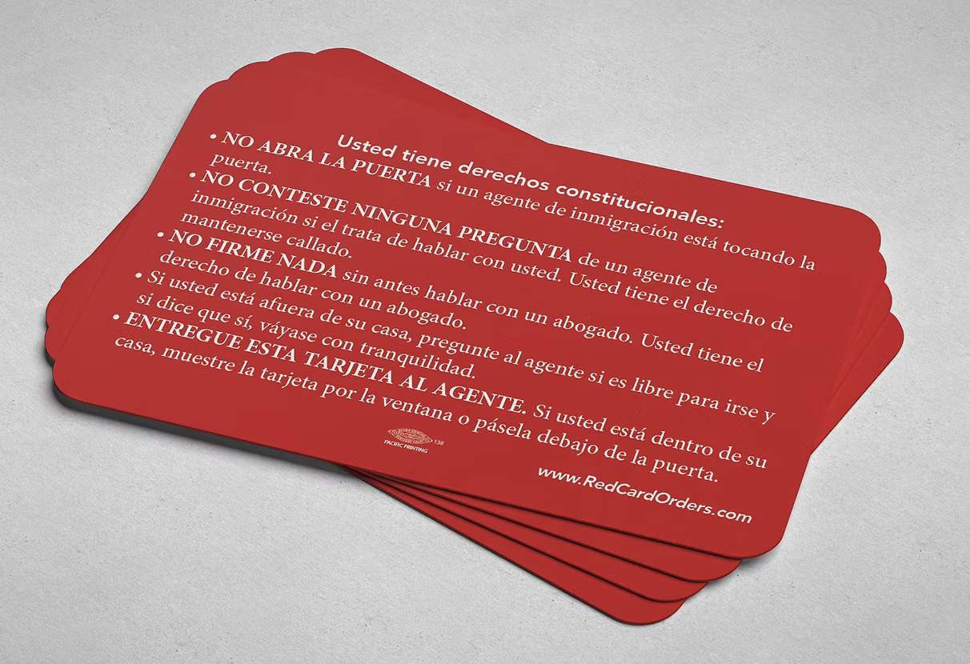
Notes:
Information like these red cards (freely available online, or you can order them in bulk) which provide a capsule listing of your rights in twenty languages.

Slide 12
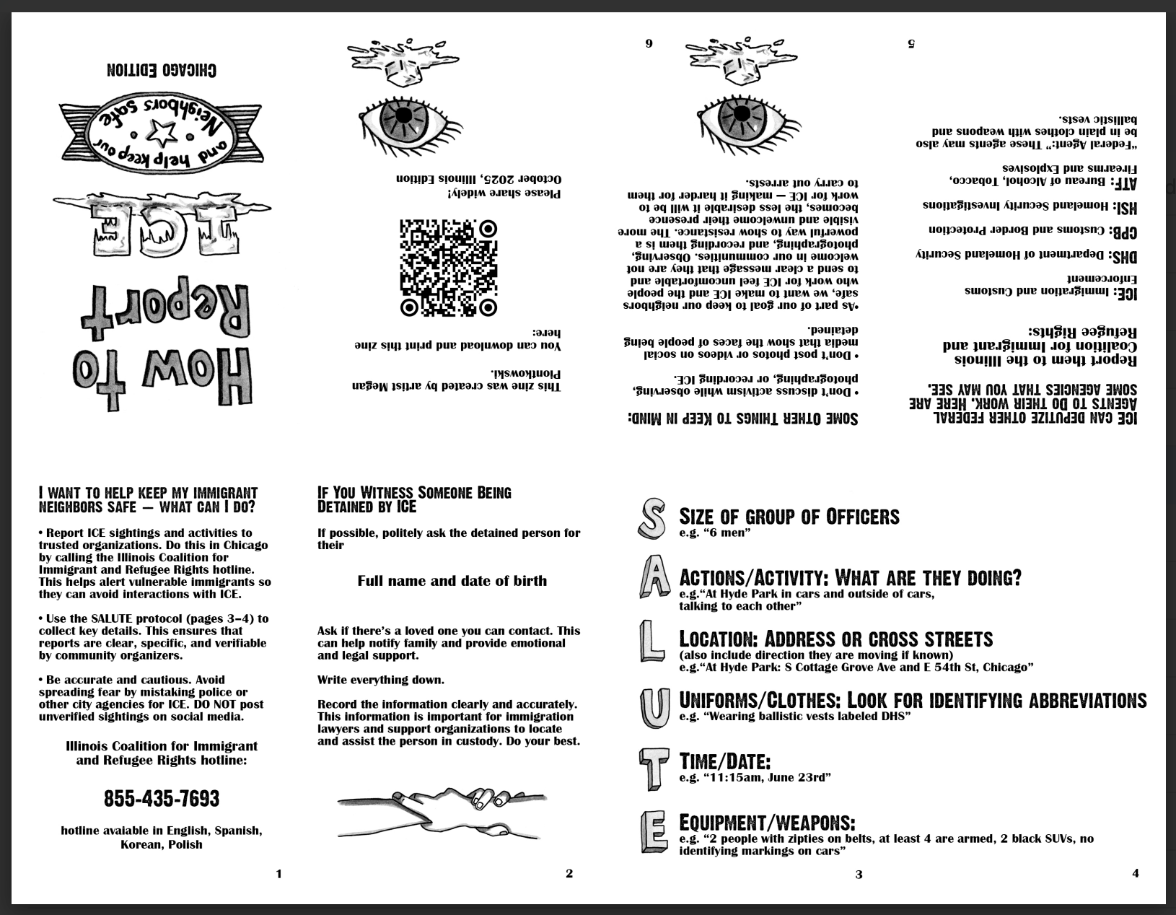
Notes:
Information like who to call if ICE is menacing your community, and what to do. These are just one-page tiny zines with local information (this one is for Chicago) or you can make up your own. Not all of these shareables can be right out there on the bulletin board, or cross-posted to social media. But there are ways to show that the library is a resource, maybe for more than just media.

Slide 13
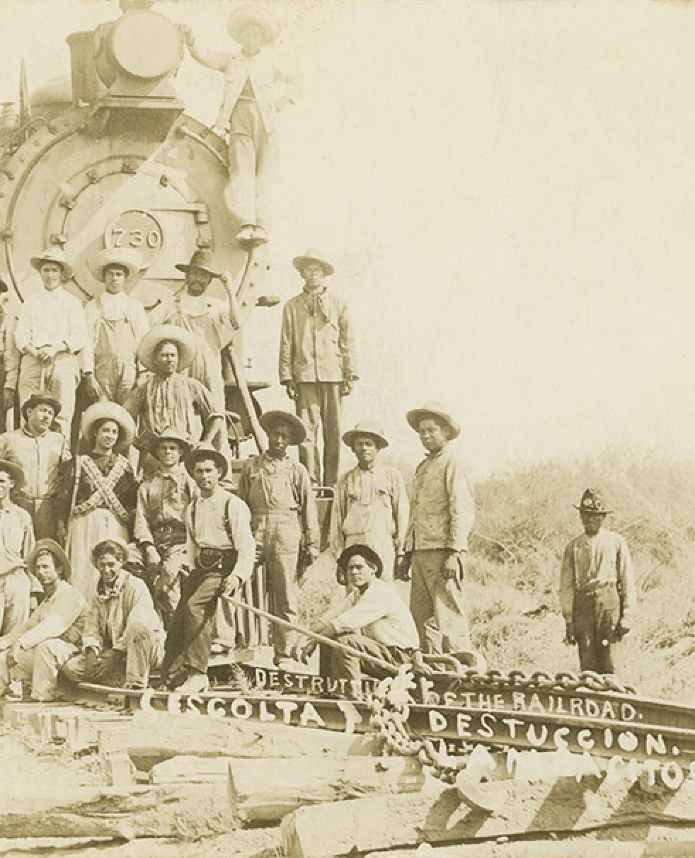
Philosophically?
it sucks to have to make choices, but...
It's better to have a plan for "how far is too far?" for yourself before you need it and hope you never need it.
You may have colleagues and friends who want to or have to make these choices differently and living with that tension is part of this.
Doing something, anything, will feel better than doing nothing.
Notes:
And then there's the philosophical aspect to this that I can't speak to as well. I shoot my mouth off a lot, I have certain levels of privilege which protect me, but I am not brave. And it's important for me to know that about myself. One of the hardest things about all of this is realizing that while we are sort of all in this together, as I said earlier, many of us have different risk profiles, personal concerns, areas of vulnerability. We're seeing white women yelling at ICE and making them go away (sometimes). We're seeing people suing the government and winning (sometimes). Maybe you're the person who can help, or be helped?

Slide 14

Day by day
hope we get through it
Notes:
Early on post-election/inauguration, I was living alone, during wintertime, watching a lot of media to keep me occupied and help the days pass. I plowed through Foyle's War like it was my job. If you haven't seen it, it's about a man who works for the police while the war starts, goes on, and ends, in a coastal town in Britain. He's very straightforward, good at his job, and manages to keep it together when other people don't. The meta-message of the show is how they often feel like the bad guy is a known enemy (Nazis usually) but often it turns out the real culprit is someone who seems like "one of us" until they don't.
Someone asked him at one point in the show how they were meant to go on (in the face of all of this awfulness) and his reply has become part of my reply to people when they ask how it's going ("you have to ask?" being too sassy). Because I get up every day. I go to work. I see and support my friends and neighbors. I keep an eye on the news that may affect me and mine (including at the library) and I try to not pay too close attention to "what has that awful man/woman done now?" I'm not a person in recovery but I very much understand the vibe of it. And as of October, that was what I'd say and where I'd end this, bleak but honest. But November has made me feel a different sort of thing.

Slide 15
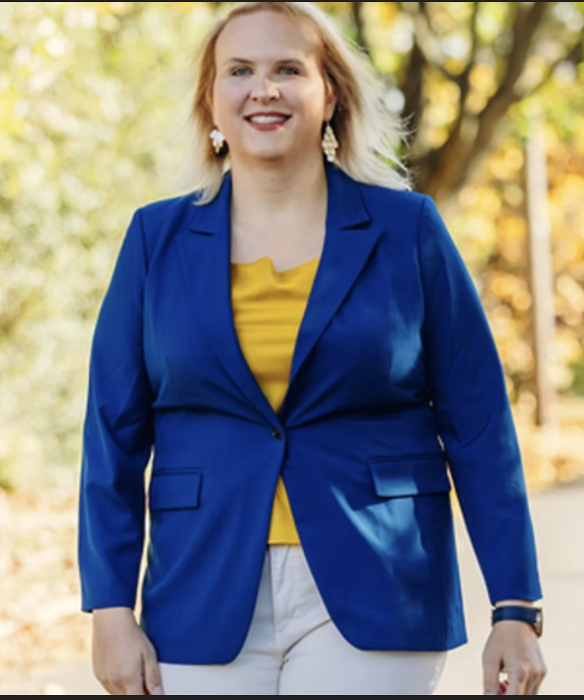
Not just zohran
people said no to moms for liberty, no to transphobia
- Erica Deuso is mayor of Downington PA
- 14 states now have female governors
- Colorado taxes the rich to feed kids
- California undoes some gerrymandering
- Moms for Liberty lost ALL their contested races
Notes:
We saw a LOT of different things happening last Tuesday. Has it only been a week? Here's a short list of the major points. And even before that, I was getting caught up in the energy of possibility. I follow a political philosopher named Olúfẹ́mi O. Táíwò (Oh-lu-FEHMey Oh TAI-wo) and one day he was re "skeet" ing some local news, something that felt like maybe it was a sign things might be going in a different, better direction. And it came with a message.

Slide 16

I do not regret to inform you that we are going to win
Notes:
He said this. And I say it to myself when good things happen, as they sometimes do. Because, hey, I honestly don't know what will happen. But I have some ideas. As one of the organizers from Protect Rogers Park (in Chicago) says “Everyone can do something, and that something will matter.”

Slide 17
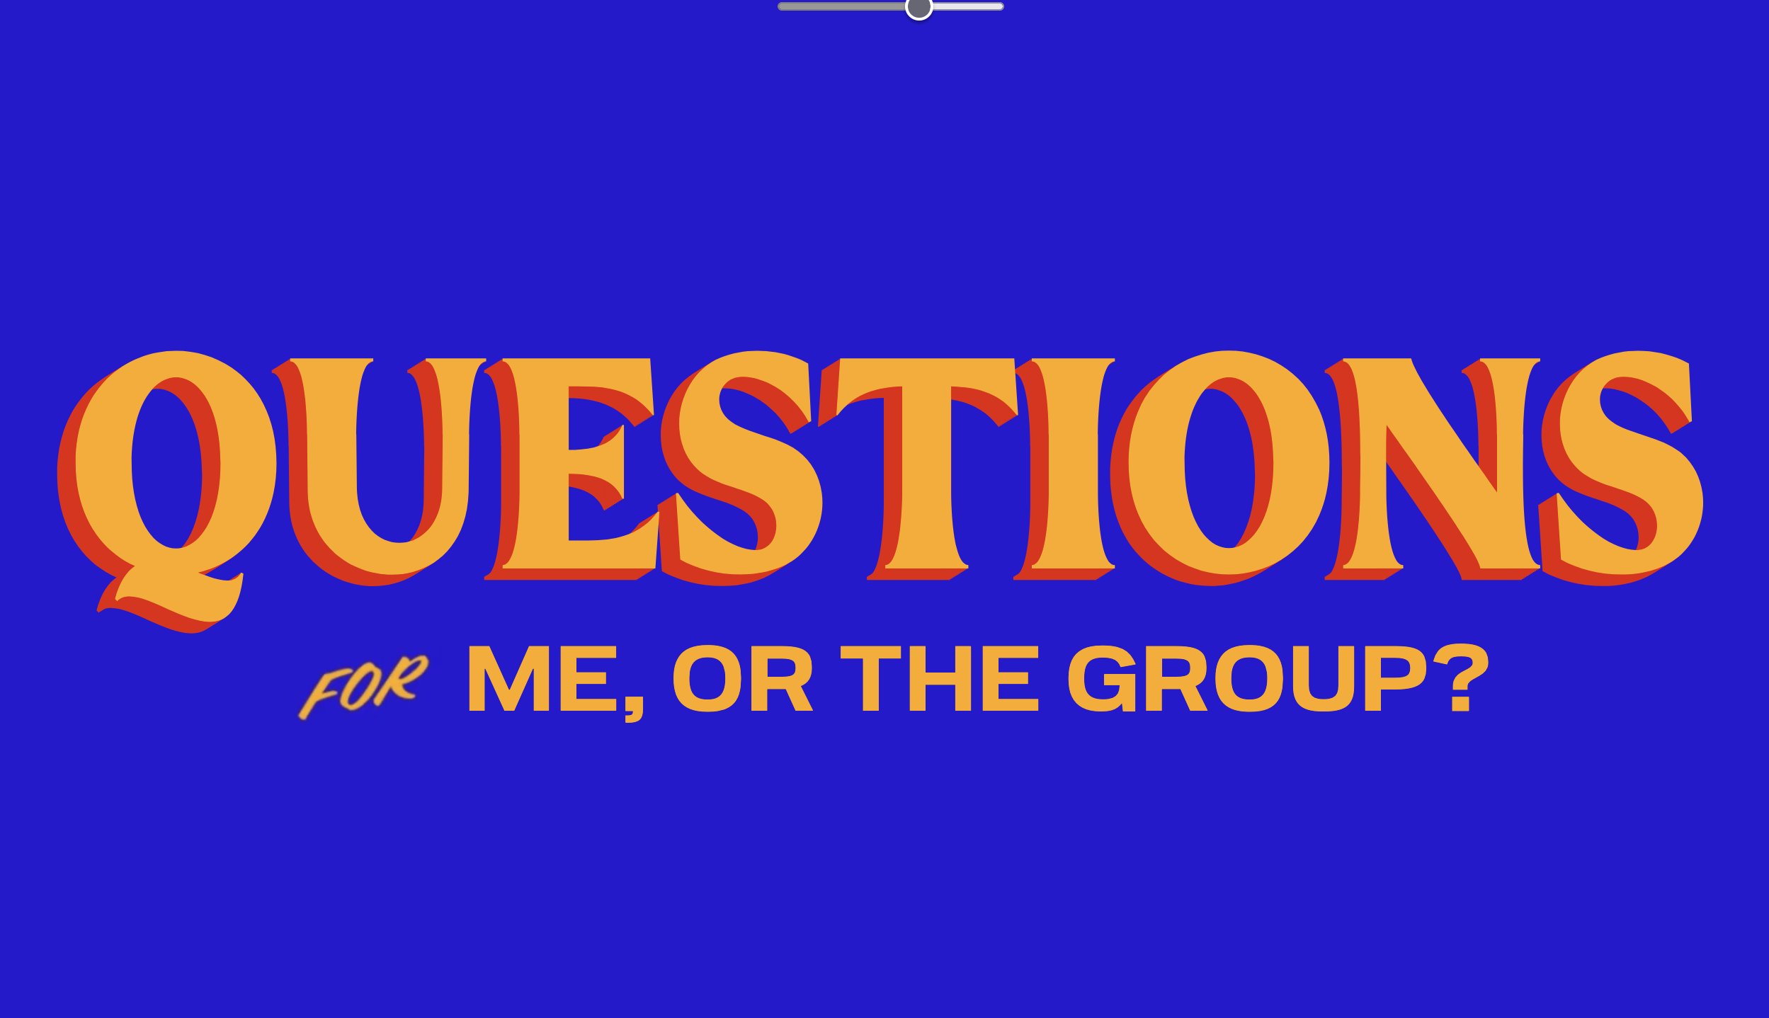

Slide 18
credits
Most non-screenshot images from Flickr Commons
stars, color: https://www.flickr.com/photos/nasacommons/16239715270/
me: https://www.flickr.com/photos/iamthebestartist/54787559960/
stars, desaturated: https://www.flickr.com/photos/nasacommons/9464531387/
stars, green: https://www.flickr.com/photos/44494372@N05/9460797842/
fox: https://www.flickr.com/photos/35740357@N03/3971218997/
defensive man: https://www.flickr.com/photos/61270229@N05/54423283242/
parachute: https://www.flickr.com/photos/49487266@N07/37407308936/
crisis https://commons.wikimedia.org/wiki/File:TheCrisisMarch1924.png
railroad: https://www.flickr.com/photos/41131493@N06/31359629045/

Slide 19
resources
URLS to things I've mentioned
printable SALUTE zines (linked, or email me for details)
Wendell Berry poem: https://www.context.org/iclib/ic30/berry/
Library Freedom Institute: https://libraryfreedom.org/institute/
Books Unbanned: https://booksunbanned.com/card
Simple Sabotage Field Manual: https://wikipedia.org/wiki/Simple_Sabotage_Field_Manual
Red cards: https://www.ilrc.org/redcards
"In Chicago, we run towards danger together" (linked, or email me for details)

