Slide 1
Internet Privacy Toolkit
Jessamyn West @ Vermont Mutual Aid Society

Slide 2
0. "threat model"
Understanding what you have to protect yourself from is an important part of this.

Slide 3
1. passwords
Why are they so complicated?
Is it OK to write them down?
Advanced: password manager.
Advanced: two-factor authentication.
Advanced: what's a passkey?

Slide 4
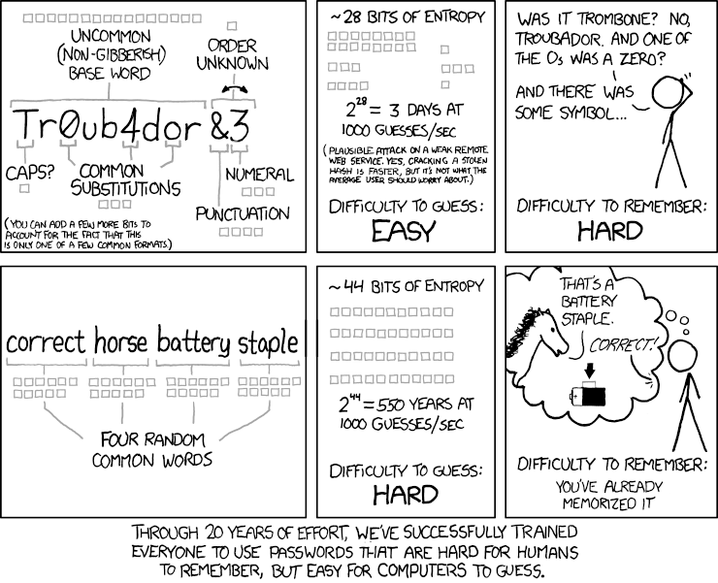

Slide 5
2. internet traffic
Private browsing. Public wifi.
Online banking/medical stuff.
Look for HTTPS. Advanced: VPN or TOR.

Slide 7
3. listening devices & AI/ChatGPT
If it's not online, it can't spy on you.
Anything that listens for your voice is actively paying attention and maybe storing your info.
Privacy for guests & others.
Siri, Alexa, Google, ChatGPT, Deepseek, your tv…

Slide 8
“Please be aware that if your spoken words include personal or other sensitive information, that information will be among the data captured and transmitted to a third party through your use of Voice Recognition”
–Samsung

Slide 9
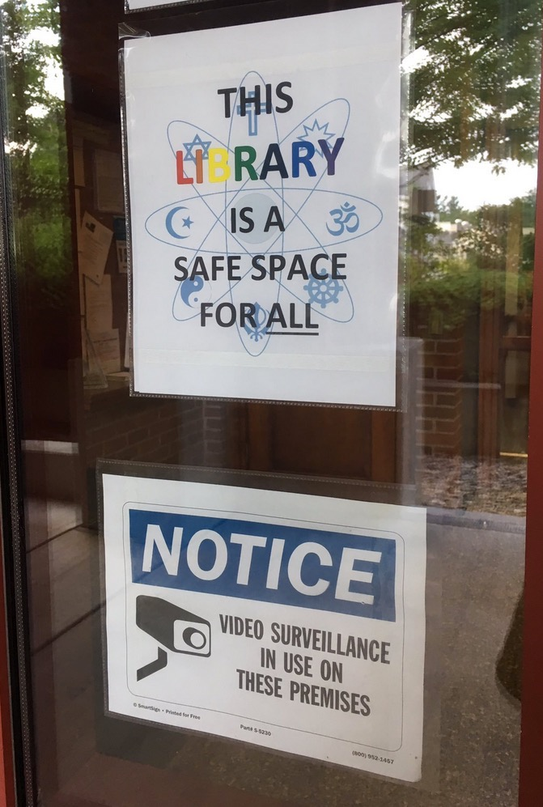

Slide 10
4. tracking
Review your browser settings.
Many browser plug-ins can stop this & are simpler to use than you think.
Don't keep all your eggs in the Google or Microsoft or Apple basket.

Slide 14
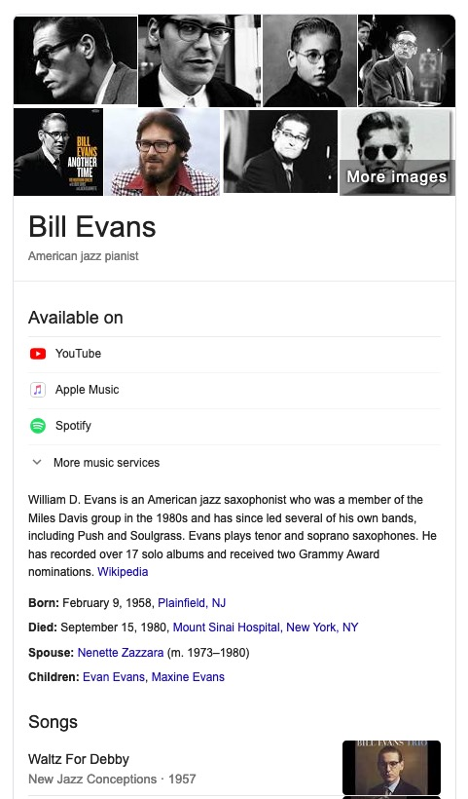
5. trust but verify
"Where does this news come from? Do I trust them?"
Don't click on mystery email links. Don't call numbers you see in pop-ups.
Know how to see where a link goes.
Advanced: tell your friends, report what's wrong.

Slide 15
Learn to live with imperfect privacy.
But don't let that stop you from trying to do better.
Help people feel good about making informed privacy choices.

Slide 16
Get your reality checked @ your library
Librarians can help you or refer you to people who can help.
jessamyn@gmail.com

